Slide 1
Database systems

Slide 2
Aim of this course
The aim of this course to provide a foundation in database concepts, models, and architecture, enabling students to understand the structure and functionality of database systems

Slide 3
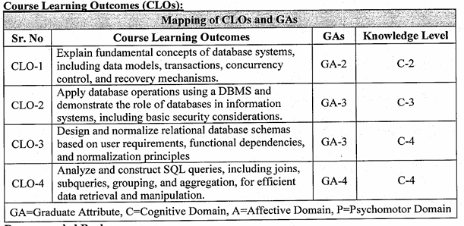
Course Learning outcomes

Slide 4
Books
1. Concepts of Database Management, Starks, Lisa Friedrichsen, Lisa Ruffolo, Ellen Monk, Cengage Learning, Latest Edition.
2. Database Management Systems, Raghu Ramakrishnan and Johannes Gehrke, McGrawHill, Latest Edition.
3. Database System Concepts, Avi Silberschatz, Henry F. Korth, and S. Sudarshan, McGrawHill, Latest Edition.

Slide 5
Marks Distribution
Sessional
(Assignment/ Quiz + Presentation)=10+10=20
Midterm
30 Marks
Final
50 Marks

Slide 6
Data
Definition: Raw facts and figures that have no meaning on their own.
Example
Numbers. 42, 105, 2023-10-27
Words: Red, Green
symbol. #,&,@

Slide 7
Information
Definition: Processed or organized data that is meaningful and useful for decision-making.
Example.
42, 105, 2023-10-27
"42 units of Product #105 were sold on October 27, 2023.“
"Red light means Stop.“
"The average score of the class is 70.

Slide 8
Database
Definition: A database is an organized collection of related data that can be easily stored, searched, retrieved, and updated.
Organized collection → Data is arranged properly.
Related data → The data is connected to a particular subject or purpose.
Stored → Data is saved for future use.
Retrieved → We can find and access the required data.
Updated → We can add, change, or delete data.
Example: A university database stores students' names, roll numbers, departments, courses, and marks in an organized way.

Slide 9
Database
Nature: Data is structured in tables, records, or documents, usually managed by a DBMS (Database Management System).
Key Point: Database = Systematic storage of data to generate information.
Example:
Names, telephone numbers, and addresses of your friends.
Each piece of information (name, phone, address) is related because it describes the same person.

Slide 10
Database
Examples:
Library Database: Stores books, authors, members, and issue records.
Bank Database: Stores customer details, account balances, and transactions.

Slide 11
Where Databases Exist
Where Databases Exist
Mobile phones → contacts app stores names & numbers.
Computer → MS Access, Excel, or other software can store the same info digitally.

Slide 12
A Database Comes from a Real Source
A Database Comes from a Real Source
Every database is built from some real-world source of data.
It reflects events and changes that happen in real life.
Example:
In a company’s HR database, if an employee is promoted, their job title, department, and salary information may be updated.
In a store database, if a customer buys a camera, the inventory count decreases automatically.

Slide 13
Database Must Stay Updated
For a database to be accurate and reliable, it must always reflect the current state of the real world.
Any change must quickly update the database.
Example:
If Amazon sells 10 laptops today, its database must immediately reduce the stock count by 10.
If it doesn’t, customers might order laptops that are already out of stock.

Slide 14
Databases Can Be Small or Huge
Small database: An address book with only a few hundred names and phone numbers.
Medium database: A library catalog with hundreds of thousands of books organized by title, author, or subject.
Huge database:
  Facebook’s database, which stores details of over a billion users, their posts, friendships, and privacy settings.
  Amazon’s database, with 60+ million users and millions of products (42 terabytes of data stored on many servers).

Slide 15
Databases Can Be Manual or Computerized
Databases Can Be Manual or Computerized
Manual database: A library’s card catalog system (drawers with cards showing book details).
Computerized database:
  Maintained by application programs (custom-built software).
  Or maintained by a Database Management System (DBMS) like Oracle, MySQL, SQL Server, etc.

Slide 16
A Database Mirrors the Real World
Every database comes from some real-world source.
It’s not static: whenever something changes in reality, the database should also change.
Example:
If a customer buys a camera, the sales database must record the purchase and reduce the stock.

Slide 17
Accuracy and Reliability Require Updates
A database should always contain the latest information.
If the information is not updated on time, it may become incorrect or confusing.
Example:
Amazon must instantly update product availability; otherwise, people could order items that are already sold out.

Slide 18
What is a DBMS?
A Database Management System (DBMS) is software that helps users create, use, and manage databases.
It’s not a database itself, but the tool that manages the database.
Examples: Oracle, MySQL, Microsoft SQL Server, PostgreSQL, MongoDB.

Slide 19
Database System = Database + DBMS
The term database system means:
  The database (the data itself).
  The DBMS software (the manager of that data).
Analogy:
Database = The library’s collection of books.
DBMS = The librarian who organizes, secures, and helps retrieve books.
Database System = The library + the librarian together.

Slide 20
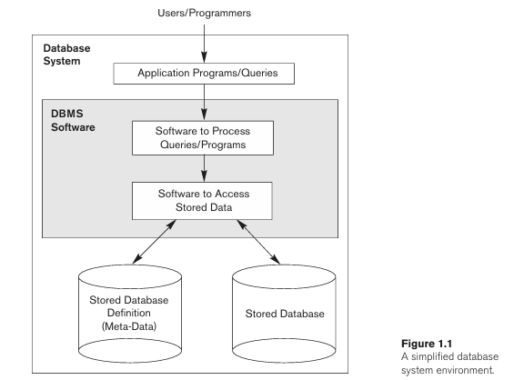
Database system Environment

Slide 21
What is Metadata?
Meta = “about”
Metadata = “data about data”
So, metadata is the descriptive information that tells the DBMS:
What data is stored? (structure)
How is it stored? (format, data type)
What rules apply? (constraints)

Slide 22
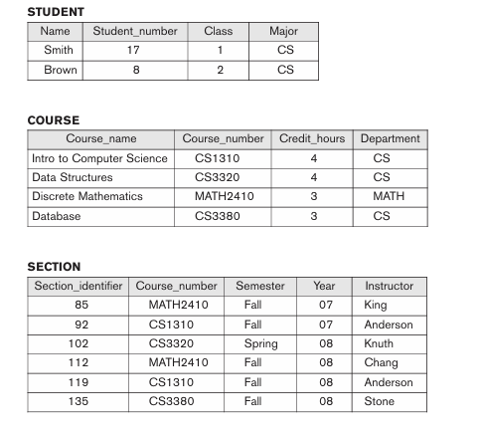
Example

Slide 23
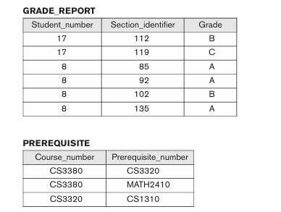
Example

Slide 24
File-Based System
In early computing, organizations stored data in separate files.
Each application (payroll, admissions, library, accounting, etc.) had its own set of files and programs to manage them.
Example.
Accounting department keeps a file (student_fees.dat)
Examination department keeps a file (student_grades.dat)
Both contain overlapping student info (like name, roll number).

Slide 25
Limitations of File-Based Systems
(a) Data Redundancy
Same data stored multiple times in different files.
Example: Student’s name and roll number stored in fees file, grade file, and hostel file.
Leads to wasted storage and unnecessary duplication.
(b) Data Inconsistency
Since data is stored in multiple places, updates may not be applied everywhere.
Example: If a student changes their major from Math to CS, the accounting file may be updated but the examination file may still show Math.
Result: conflicting or incorrect information.

Slide 26
Limitations of File-Based Systems
(c) Data Isolation
Data is scattered across many separate files, often in different formats.
Example: One file stores StudentID as an integer, another as a string.
This makes it hard to combine information (e.g., linking grades with fee payments).

Slide 27
Limitations of File-Based Systems
(d) Integrity Problems
No centralized control means rules and constraints are hard to enforce.
Example:
  Roll numbers must be unique.
  Credit hours should be positive.
In file-based systems, every program must implement these checks separately → high chance of errors or violations.

Slide 28
Characteristics of the Database Approach
Database Approach:
  A single database repository stores data once.
  All users access it through the DBMS (queries, transactions, programs).
  No unnecessary duplication, and changes update everywhere automatically.

Slide 29
1. Self-Describing Nature of a Database System
A Database Management System (DBMS) stores the actual data as well as information that describes the data. This information is called metadata.
Metadata means “information about data.”
Metadata includes:
Table structure: Tells us the table name, column names, and how tables are connected.

Slide 30
Data types: Tells us what type of data can be stored, such as:
  Integer → whole numbers, e.g., 25
  String → text, e.g., "Ali"
  Date → e.g., 23-08-2026
  Boolean → True or False
Rules (Constraints): Rules that control the data, such as:
  Primary Key → uniquely identifies each record.
  Unique → prevents duplicate values.
  NOT NULL → a value cannot be left empty.
  Foreign Key → connects one table to another.

Slide 31
1. Self-Describing Nature of a Database System
Example:
If we want the Name of a student, the DBMS checks the catalog to know:
In which table the data exists.
Which column stores it.
What type of data it is (string, text, etc.).
Any rules that apply to it.

Slide 32
2. Insulation Between Programs and Data (Program–Data Independence)
In DBMS
Data definitions are stored centrally in the catalog (data dictionary).
Programs interact with data through the DBMS, not directly with file structures.
If you add a new field (like birth date in STUDENT), you only update the catalog; the existing programs don’t break.

Slide 33
3. Support of Multiple Views of Data
Different people use the same database for different purposes. They do not need to see all the information.
DBMS allows creation of views (subsets or derived data).
A view is a customized way of showing only the information a particular user needs.
Example
Suppose a university database contains:
Student Name | Roll No. | Course | Grade | Fees | Address | Phone Number
Registrar: May need a Transcript View showing:
  Student Name , fees.

Slide 34
Course Coordinator: May need a Prerequisites View showing:
  Course Name
  Prerequisite Course
The registrar does not need to see fees or phone numbers, and the course coordinator does not need all student details.

Slide 35
4. Sharing of Data and Multiuser Transaction Processing
A DBMS allows many users to use the same database at the same time.
Example:
In an airline reservation system, many people may try to book seats at the same time. The DBMS makes sure that two people cannot book the same seat.
What does the DBMS do?
Concurrency Control:
It manages multiple users so that their actions do not conflict with each other.
Example: If two agents try to book Seat 15 at the same time, only one should be able to book it.

Slide 36
Transaction Properties
A transaction is a group of related operations that should be completed as one unit.
Atomicity:
Either all operations are completed, or none are completed.
Example: When transferring money, money should be deducted from one account and added to the other. If something goes wrong, the whole transaction is cancelled.
Isolation:
The DBMS keeps the transactions isolated until the changes are properly completed.
Example: If two people are making transactions at the same time, one transaction should not see incomplete changes from the other.

Slide 37
4. Sharing of Data and Multiuser Transaction Processing
Consistency
Consistency means that the database must remain correct and follow all its rules before and after a transaction.
A transaction should not leave the database in an incorrect or invalid state.
All database rules and relationships must remain valid.
If a transaction breaks a rule, the DBMS rejects or cancels it.
Example. If you transfer $500 from Account A to Account B, the total balance should remain the same before and after the transaction.

Slide 38
4. Sharing of Data and Multiuser Transaction Processing
Durability
Ensures that once a transaction is committed, its results are permanent.
Even if there is a power failure, crash, or system restart, the committed data must not be lost.
DBMS achieves this using logs, backups, and recovery mechanisms.
Example. If money is transferred and the bank confirms it, the transaction is guaranteed—it will not be rolled back, even if the system fails right after.

Slide 39
Main Functions of a DBMS
The DBMS performs four core functions:
(a) Defining a Database
Decide what data will be stored, what structure it will have, and what rules (constraints) apply.
This description is stored in a special place called the database catalog (or data dictionary).
This descriptive information is called metadata (data about data).
Example:
In a university DB:
  A student ID must be a number.
  A grade can only be A, B, C, D, or F.
  These rules are part of the definition.

Slide 40
Main Functions of a DBMS
(b) Constructing a Database
Actually, storing the data on disk, SSD, or other storage media.
The DBMS controls how data is organized internally so that it can be efficiently accessed.
Example:
Saving student records into tables inside the DB.

Slide 41
Main Functions of a DBMS
C) Manipulating a Database
Manipulating a database means using the data and making changes to it.
There are three common operations:
Querying: Asking the database to find specific information.
Example: “Show me all students studying Computer Science.”
Updating: Changing existing information in the database.
Example: “Change Ali’s major from Computer Science to Software Engineering.”
Reporting: Preparing useful summaries from the data.
Example: “Calculate the average GPA of all students.”

Slide 42
Main Functions of a DBMS
(d) Sharing a Database
Multiple users and applications can access the database at the same time.
The DBMS ensures consistency and prevents conflicts.
Example:
In a bank DB, one customer withdraws money from an ATM while another transfers money online — both can happen safely at the same time.

Slide 43
How Applications Talk to a Database
Applications (like a banking app, e-commerce website, or payroll system) don’t directly access the database.
The DBMS acts as a middleman between the application and the database.
They send queries or requests to the DBMS.

Slide 44
Extra Functions of a DBMS
The DBMS does more than just store and retrieve data. It also:
Protects the Database
System Protection → Prevents data loss from crashes, hardware failure, or software bugs.
Security Protection → Ensures only authorized people can access data (passwords, permissions, encryption).
Example:
If a server crashes during a bank transfer, the DBMS ensures money is not lost or duplicated.
Unauthorized users can’t just open the bank’s database and see account details.

Slide 45
Maintains the Database Over Time
Large databases may exist for years or decades.
A database is not normally created for only a few months. Organizations such as universities, banks, hospitals, and companies may use the same database for many years.
Example:
A university database might start with only student names and grades.
Later, it might need to add online course modules, payment records, and research data — all without starting over.

Slide 46
General-Purpose DBMS vs. Special-Purpose Software
General-Purpose DBMS:
  Used for many kinds of applications (Oracle, MySQL, SQL Server).
  Flexible and reusable.
Special-Purpose DBMS (Custom Programs):
  Built for a single, specific application.
  Example: An airline reservation system may use custom-built database software.
  These can be faster for one job, but less flexible.

Slide 47
Advantages of using a DBMS.
1.Data Redundancy and Inconsistency Control
In file systems, the same data might be stored in many places (redundancy), leading to inconsistency.
A DBMS centralizes data storage, reducing duplication and ensuring consistency.
Example: In a university DB, a student’s address is stored once, not separately in “fees,” “library,” and “exam” files.

Slide 48
Advantages of using a DBMS
2. Data Sharing and Multiuser Access
A DBMS allows multiple users and applications to access the same data simultaneously.
It ensures consistency even when many people are working on it at once.
Example: In a bank, thousands of ATMs can access and update customer balances at the same time safely.

Slide 49
Advantages of using a DBMS
3 Data Integrity and Accuracy
A DBMS enforces rules (constraints) to ensure only valid data is stored.
Example: A student’s grade can only be A, B, C, D, F — not “Z.”

Slide 50
Advantages of using a DBMS
4.Data Security
DBMSs provide strong security features:
  Authentication (who can log in).
  Authorization (who can view/modify certain data).
  Encryption.
Example: In a hospital DB, only doctors can access medical records; accountants can only see billing info.

Slide 51
Advantages of using a DBMS.
5. Backup and Recovery
DBMSs automatically provide backup and recovery mechanisms.
Even if the system crashes, data can be restored to a consistent state.
Example: In case of a power failure during a bank transfer, the DBMS ensures money is not lost or duplicated.

Slide 52
Advantages of using a DBMS
6. Data Independence
Applications are insulated from changes in how data is physically stored.
Developers can change storage structures without changing application programs.
Example: Adding a new field “student email” in the DB doesn’t break existing applications.

Slide 53
Advantages of using a DBMS
7. Efficient Data Access
DBMSs provide powerful query languages (like SQL) to quickly retrieve, update, and analyze data.
Much faster than searching through raw files.
Example: Finding “all students in Computer Science with GPA > 3.5” is one SQL query instead of manually scanning records.

Slide 54
Advantages of using a DBMS
8. Better Data Administration
A DBMS provides a centralized system to manage data.
Easier for administrators to monitor usage, performance, and security.
9. Support for Concurrent Transactions
Many users can perform transactions at the same time without interfering with each other (thanks to concurrency control).
Example: Multiple people booking airline seats at the same time — the DBMS ensures no two people get the same seat.

Slide 55
A Brief History of Database Applications
Early Database Applications (1960s–1980s)
Used hierarchical and network database systems.
Mainly applied in large organizations (corporations, universities, hospitals, banks).
Records had fixed, similar structures (e.g., student info, course info, grade info).
Problems:
  Data relationships were mixed with physical storage (e.g., grade records stored next to student record).
  Hard to adapt when requirements changed (new queries = new programs).
  Only programming language interfaces (no easy query tools).
These ran on mainframe computers, expensive and rigid.
Example: If you wanted a new report in a university DB, programmers had to rewrite big chunks of code.

Slide 56
Relational Databases (1970s–1980s, Dominant Today)
Introduced by E. F. Codd in the 1970s.
Key idea: Separate conceptual data (tables, relationships) from physical storage.
Introduced SQL query language → easier and faster to create new queries.
Provided data abstraction and program-data independence.
Initially slow, but improved with better indexing, optimization, and storage.
Became the dominant DBMS model used everywhere (small PCs to large servers).

Slide 57
Object-Oriented Databases (1980s–1990s)
Came with the rise of object-oriented programming (C++, Java).
Could store complex data like multimedia, CAD designs, and engineering objects.
Supported features: abstract data types, inheritance, encapsulation, object identity.
Useful for specialized fields (engineering design, multimedia publishing).
Did not replace relational databases but influenced them → led to object-relational DBMS (ORDBMS).
Example: A multimedia DB storing videos and images as objects.

Slide 58
Web & E-Commerce with XML (1990s–2000s)
With the growth of the World Wide Web, databases powered e-commerce.
Web pages often display dynamic data extracted from DBMSs (e.g., product prices, flight info).
XML (extended Markup Language) became a standard for exchanging data between databases and web pages.
Example: Amazon product listings or airline flight search pages.

Slide 59
Extended Database Capabilities (2000s)
DBMSs added support for specialized applications beyond traditional business data.
Applications included:
  Scientific databases (genome data, physics experiments).
  Image/video storage (X-rays, MRI scans, photos).
  Data mining (detecting fraud patterns).
  Spatial databases (maps, weather data, GPS).
  Time-series databases (economic trends, daily stock prices).
Needed new data types, query operations, storage methods.
DBMSs added optional modules (e.g., a time-series module).
Example: A hospital storing both patient records and X-ray images in the same DB system.

Slide 60
Big Data & NoSQL Databases (2000s–Present)
With social media, search engines, e-commerce, and cloud computing, data exploded.
Traditional SQL databases struggled with huge volumes and unstructured data (tweets, posts, logs).
NoSQL databases emerged (Not Only SQL):
  Handle massive, distributed data.
  Provide fast search and retrieval.
  Support nontraditional data (documents, graphs, key-value stores).
Often used together with SQL systems depending on application needs.
Example:
Facebook uses SQL databases for structured data (user info) + NoSQL databases for unstructured data (posts, messages, media).

Slide 61
When Not to Use a DBMS
We avoid using a DBMS when:
The application is simple, fixed, and small.
Real-time speed is more important than DBMS features.
Storage is limited (embedded systems).
Only one user needs access.
In such cases, custom file-based solutions may be better.

